Slide 1
Overview of Dev Ops
Day1

Slide 2
Methods before DevOps
Water fall model
Agile method
DevOps method

Slide 3
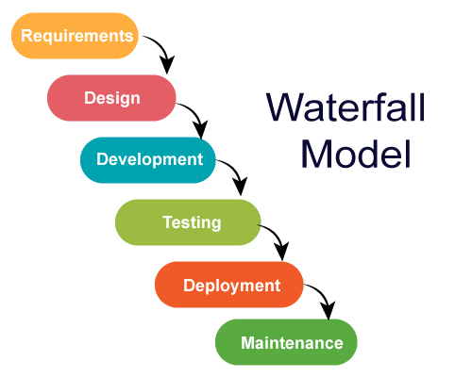
Waterfall model
No back step
Only sequential order
Long completion time
If any error in middle, rework from first
No addons in between
No parallel work assignment to Dev &Test teams
No proper coordination between Dev, Test, Ops teams

Slide 4
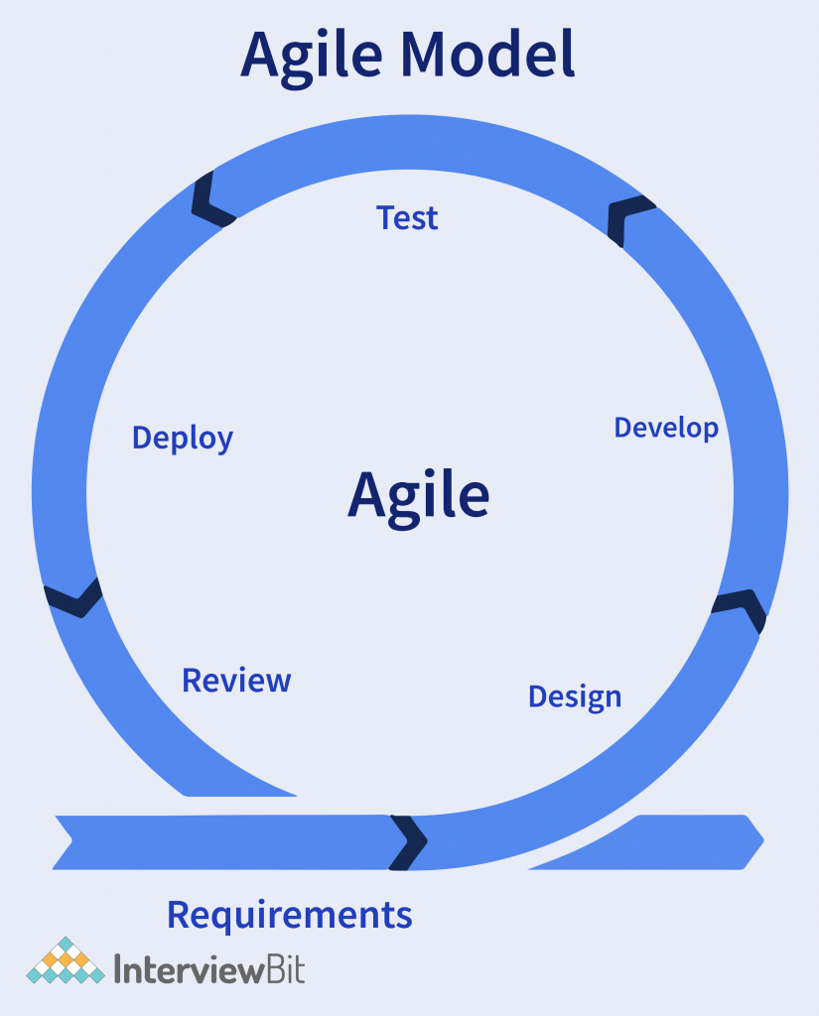
Agile Method
Agile is a process by which a team can manage a project by breaking it up into several stages and involving constant collaboration with stake holders and continuous improvement and iteration at every stage.
Project motham okke sari cheyakunda parts parts ga ready chesi production loki nukuthar so that we can cover the drawbacks of waterfall model
Manual deployment and monitoring- drawback for ops team

Slide 5
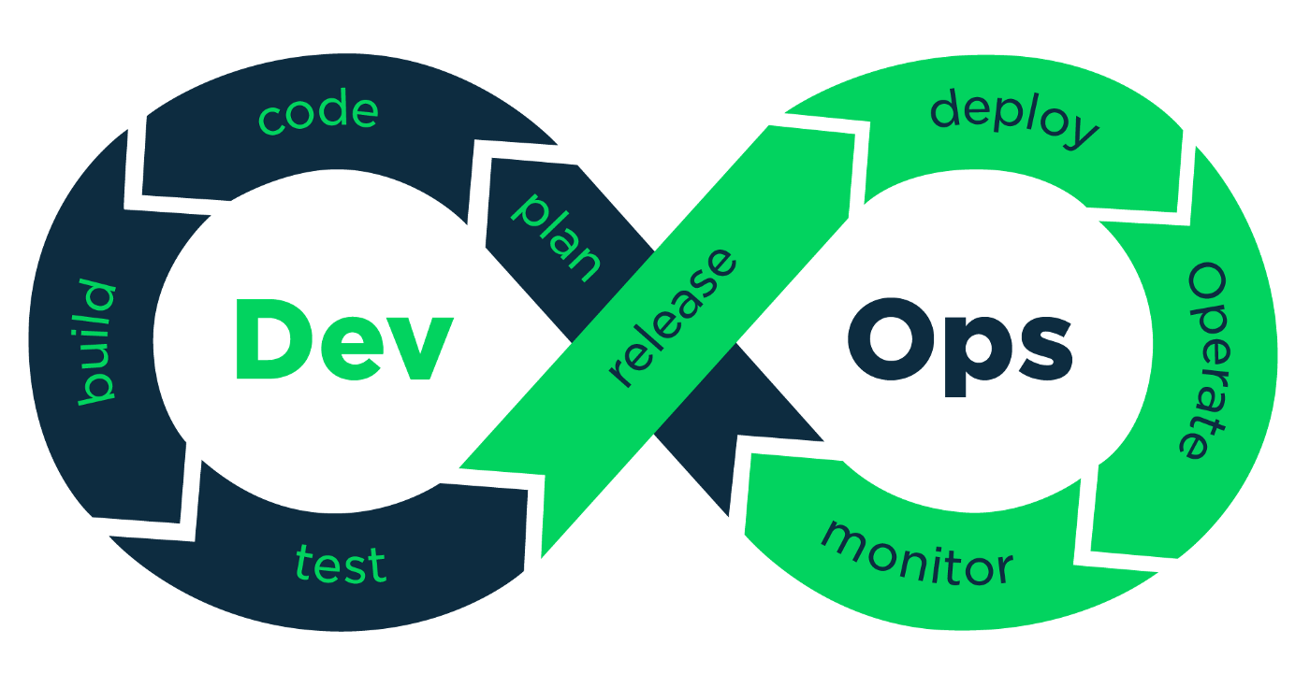
DevOps method
DevOps is a set of tools that combines s/w development and IT operations.
Shorten Systems dev life cycle
Continues upgrades delivery
High s/w quality
It is the complimentary of Agile s/w development

Slide 6
Dev & Ops
Development Team
Developers
Testers
Operations Team
Infra
System/Admin
Dba
Networking
Security

Slide 7
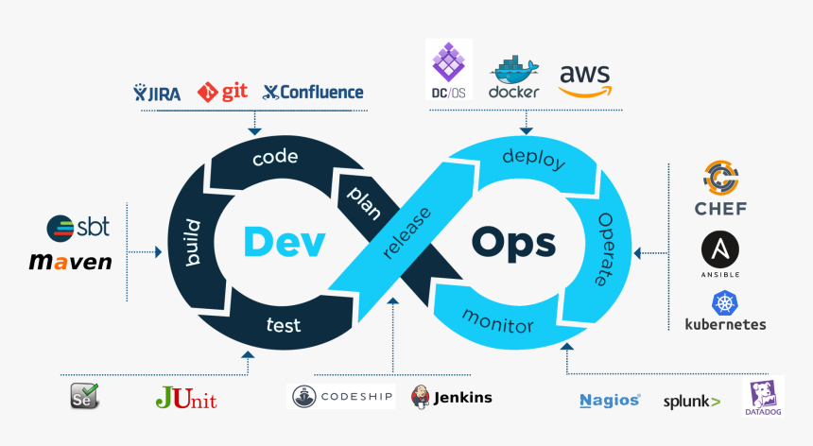
Tools of DevOps at different stages
Linux
Git – Jaaga to store code online
Maven – stored data is converted to ML code
Tomcat
Jenkins
Ansible
Docker
Kubernetes
Nagios
Shell scripts
AWS – Cloud service

Slide 8
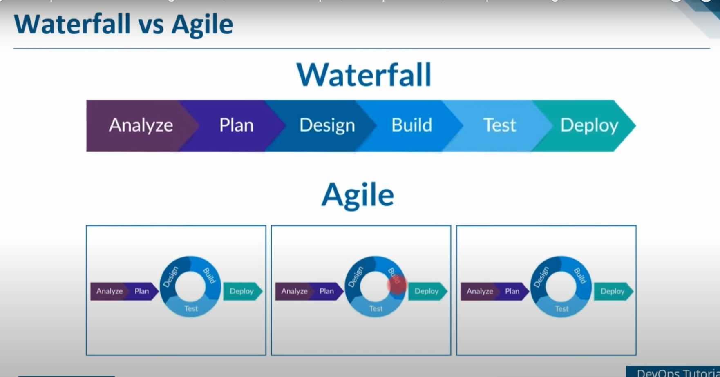

Slide 9
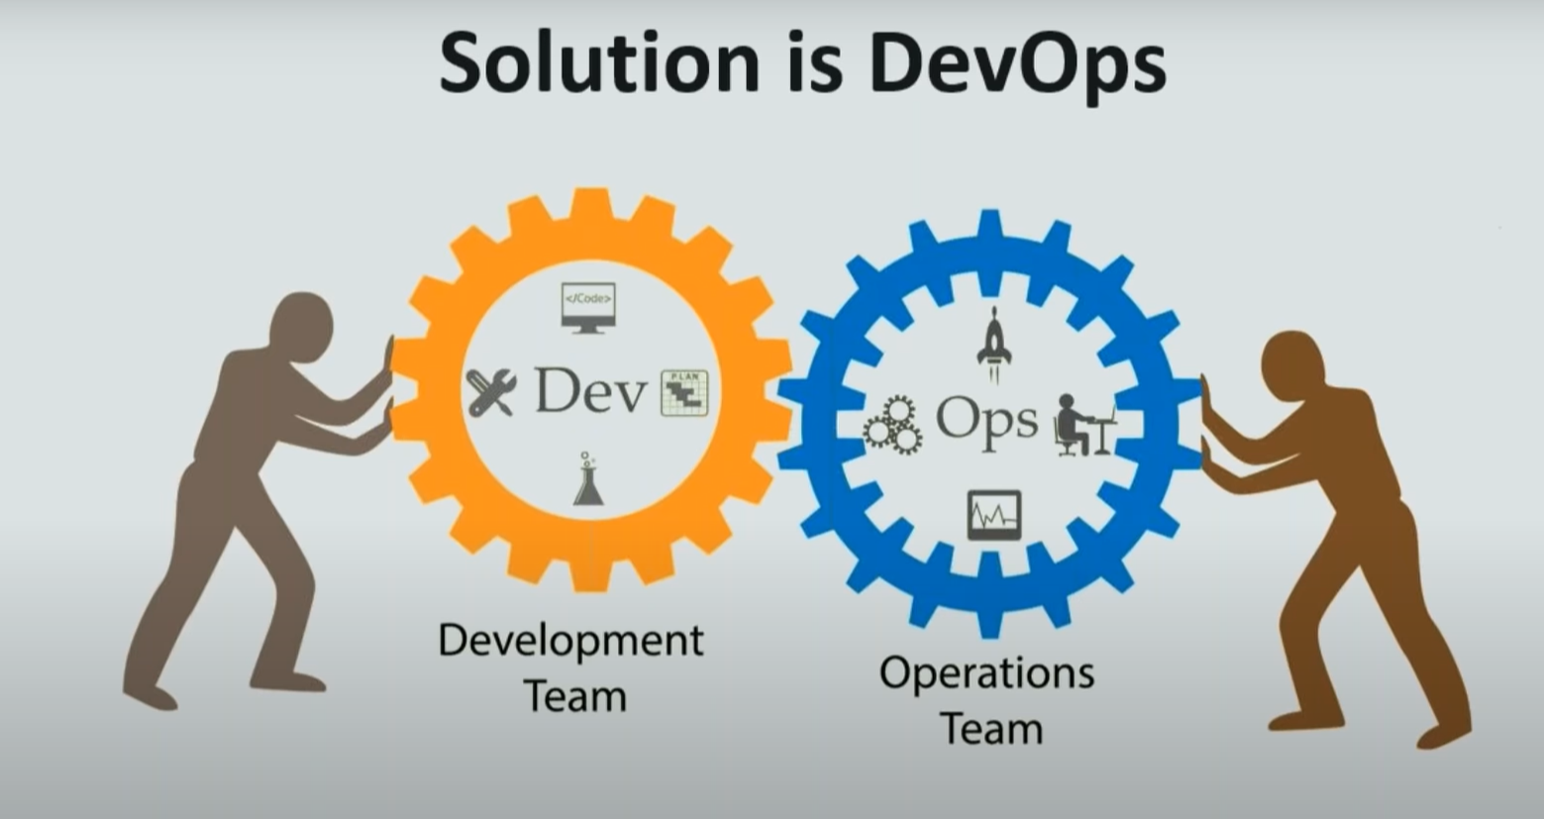

Slide 10
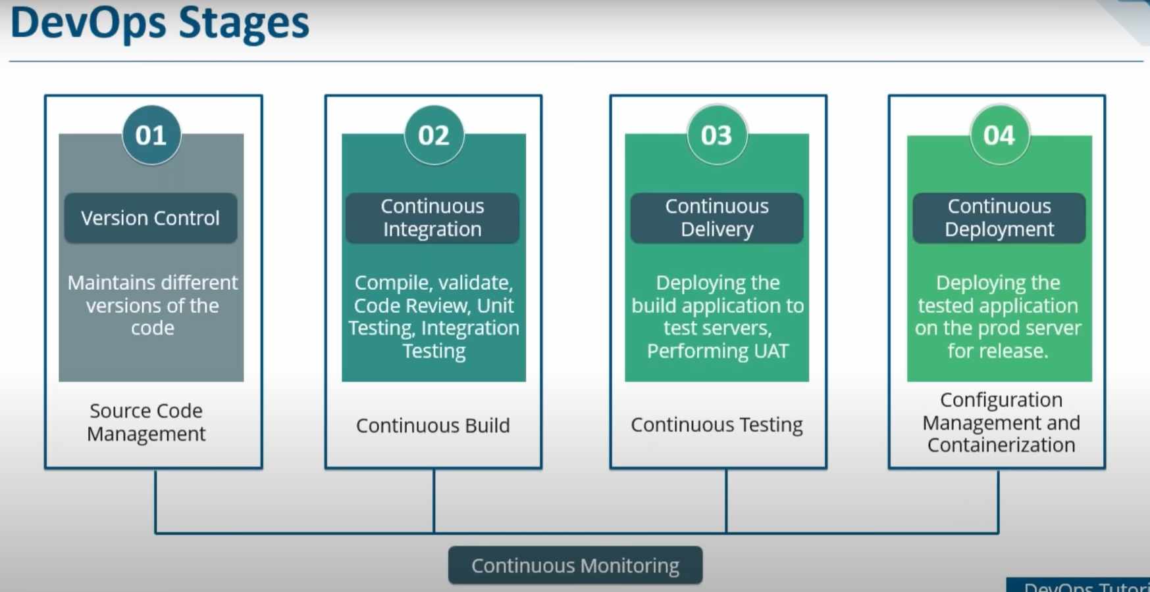

Slide 11
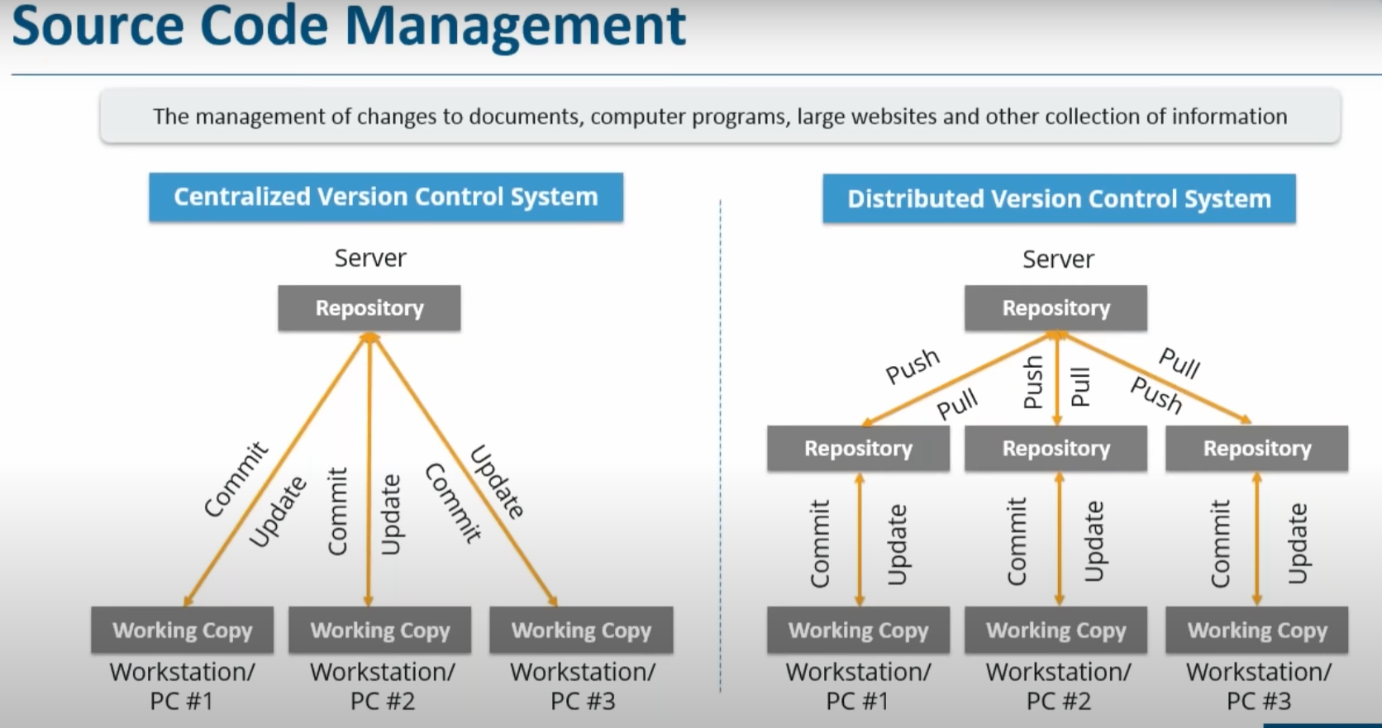

Slide 12
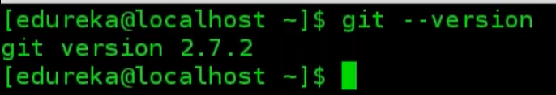
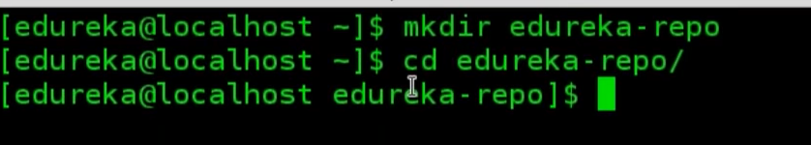
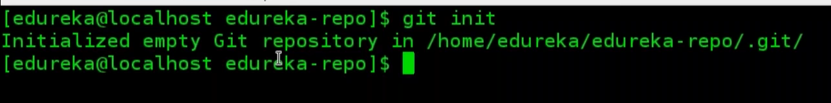
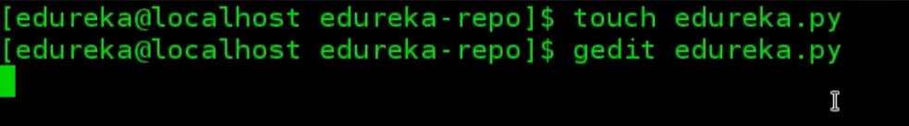
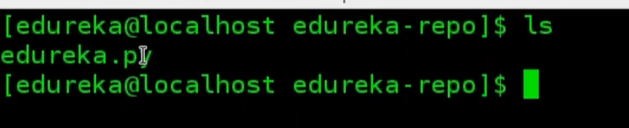


Slide 13
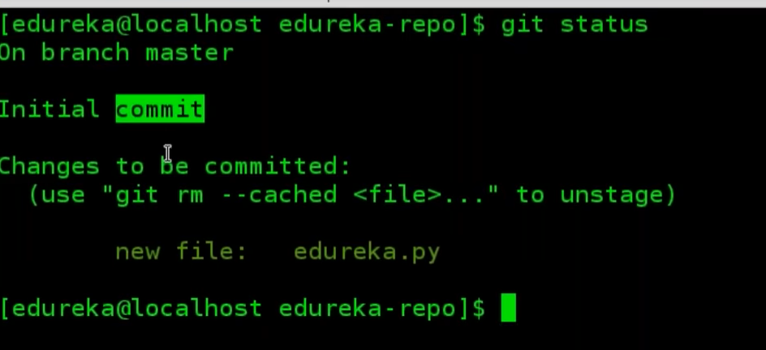
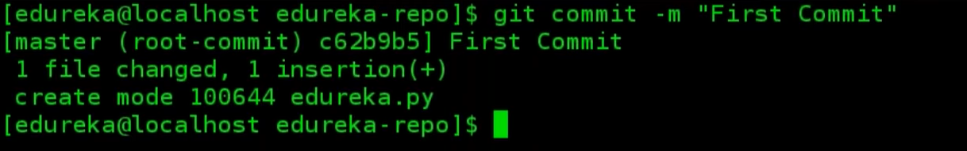
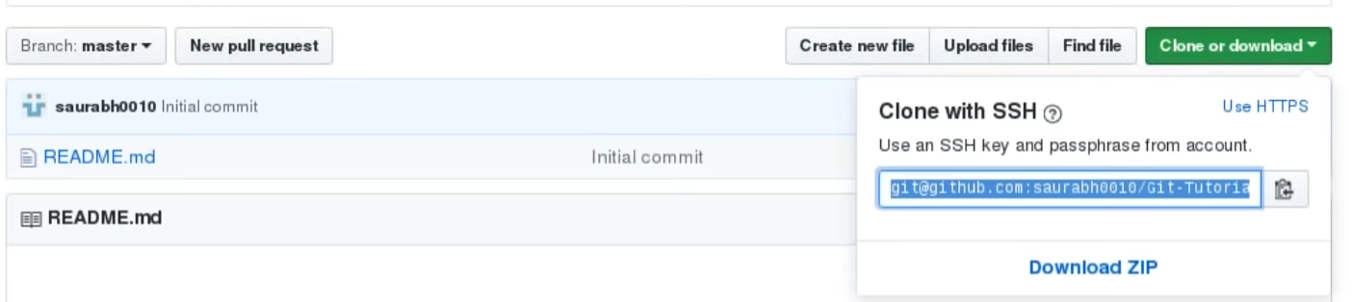

Slide 14


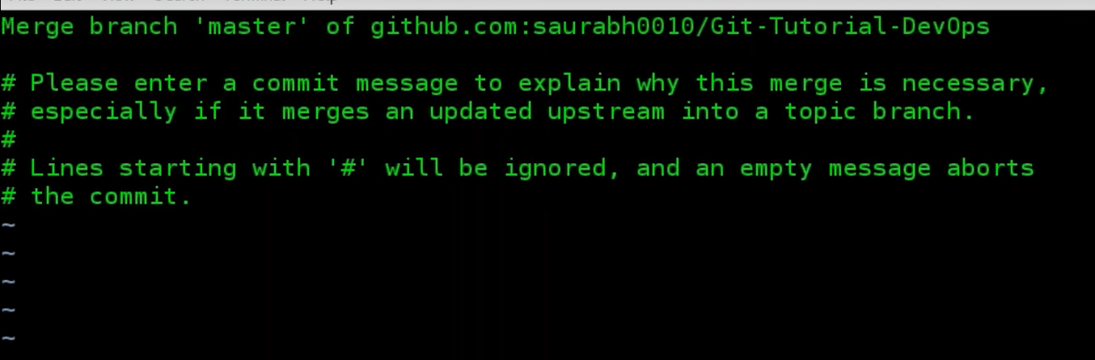

Slide 15
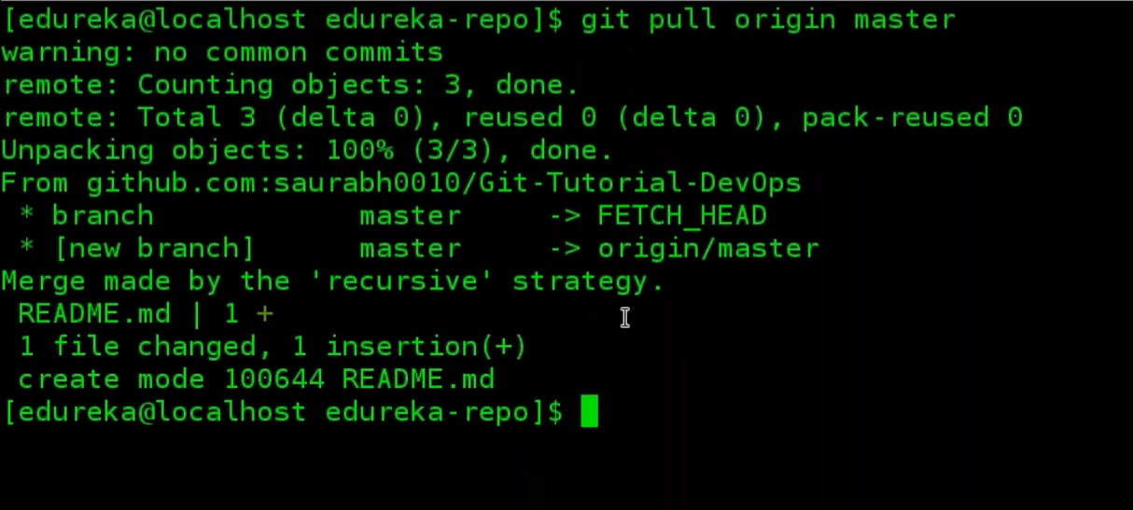
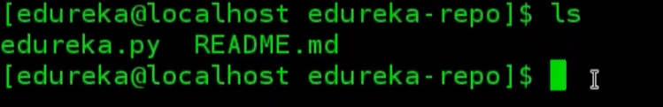
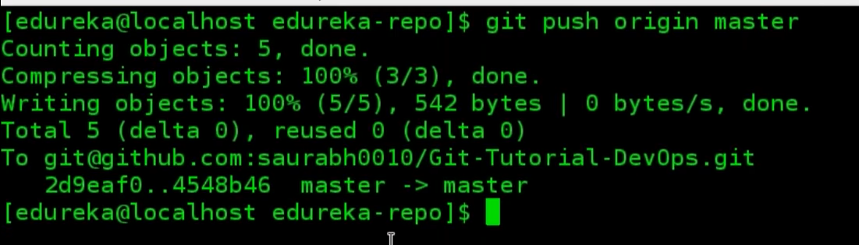

Slide 16
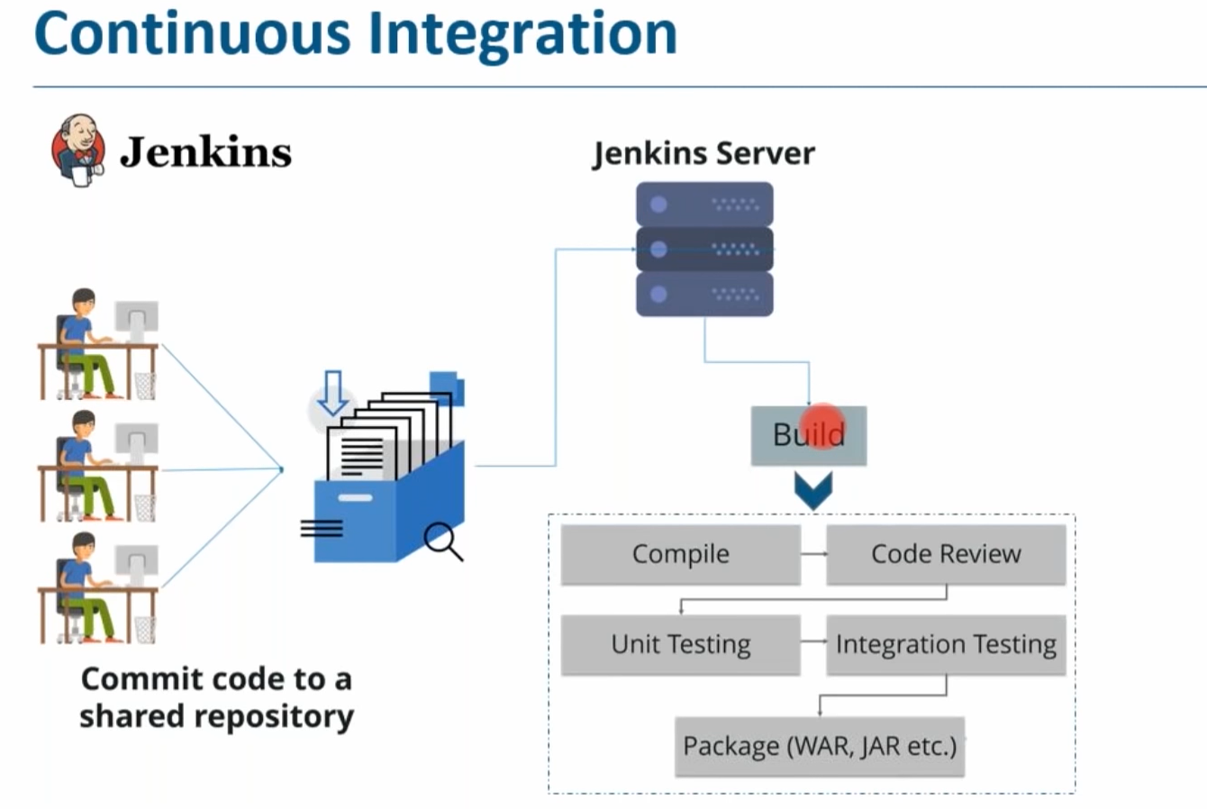

Slide 17
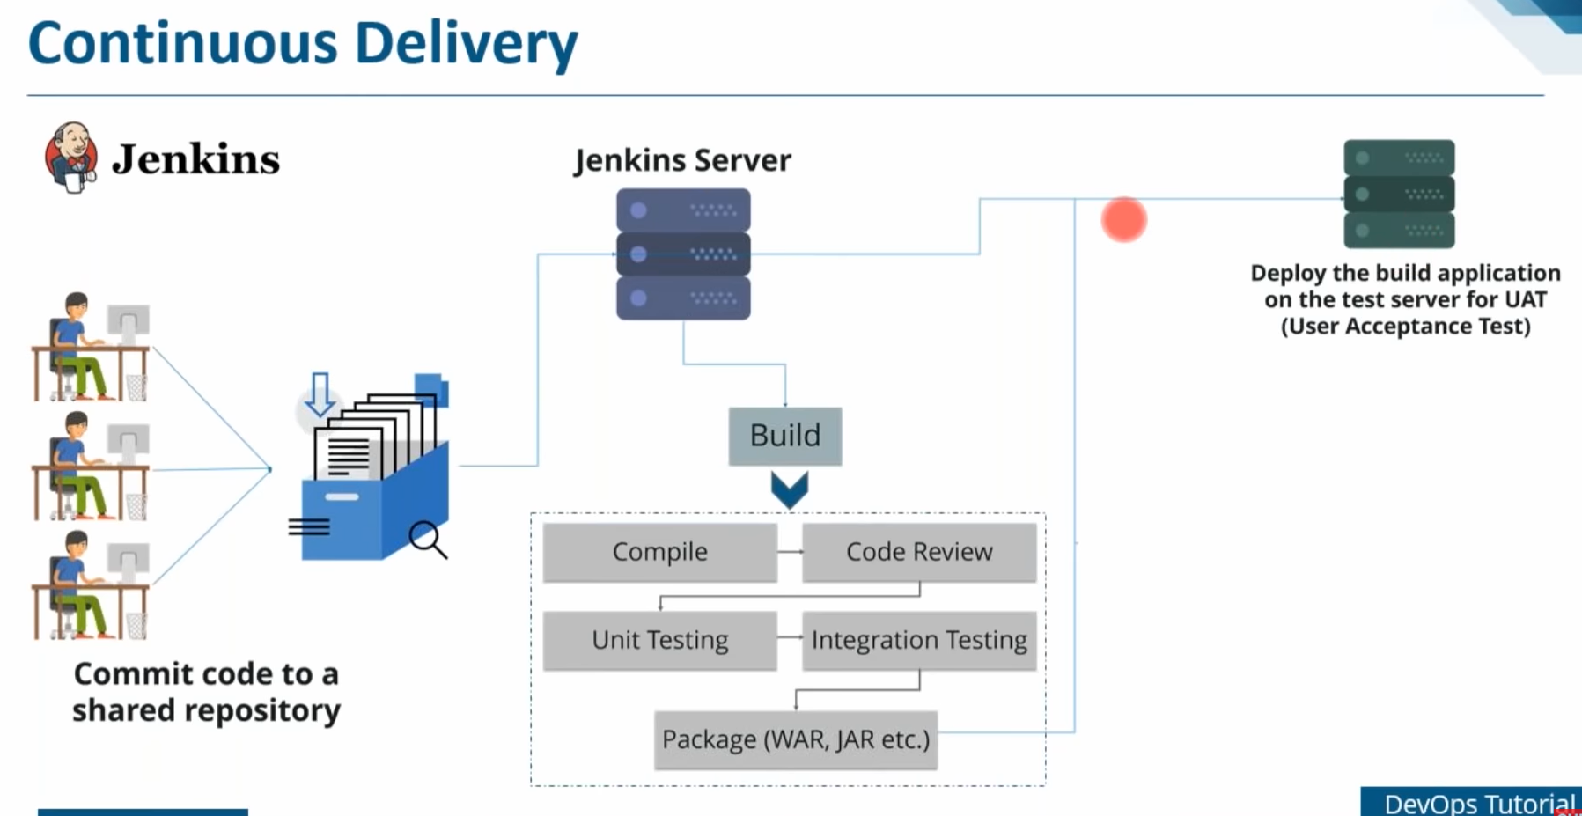

Slide 18
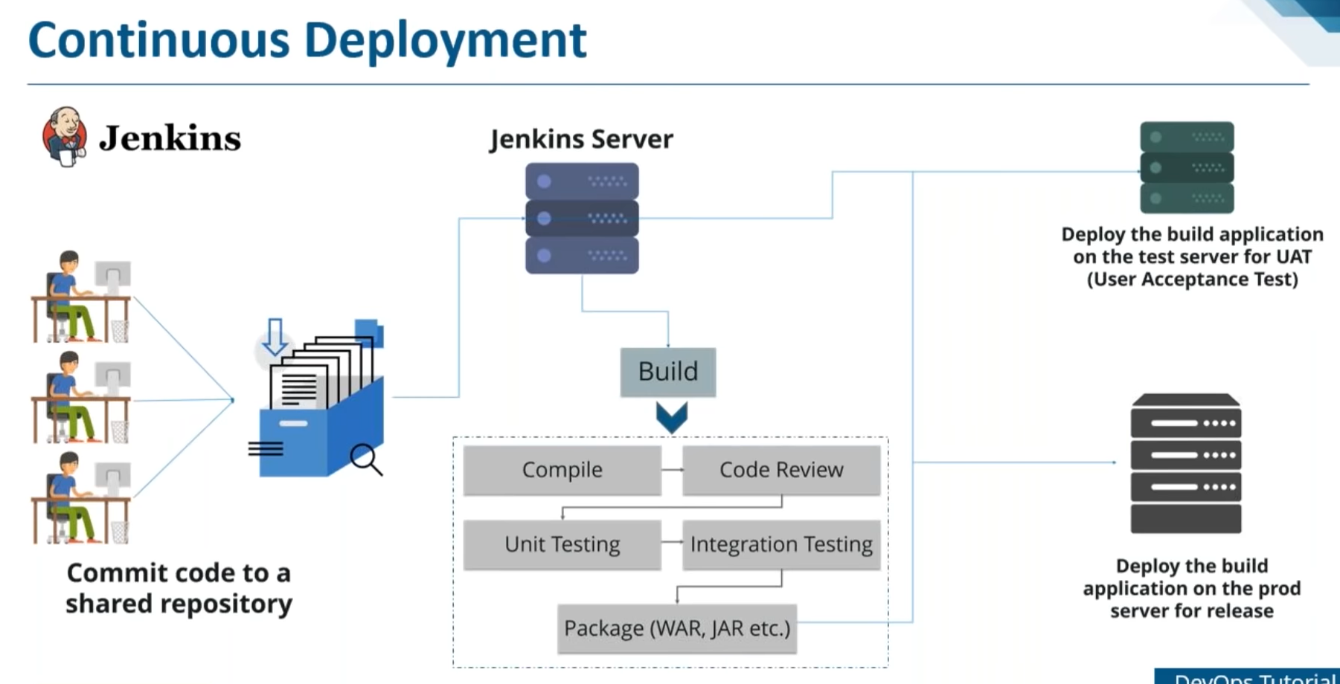

Slide 19
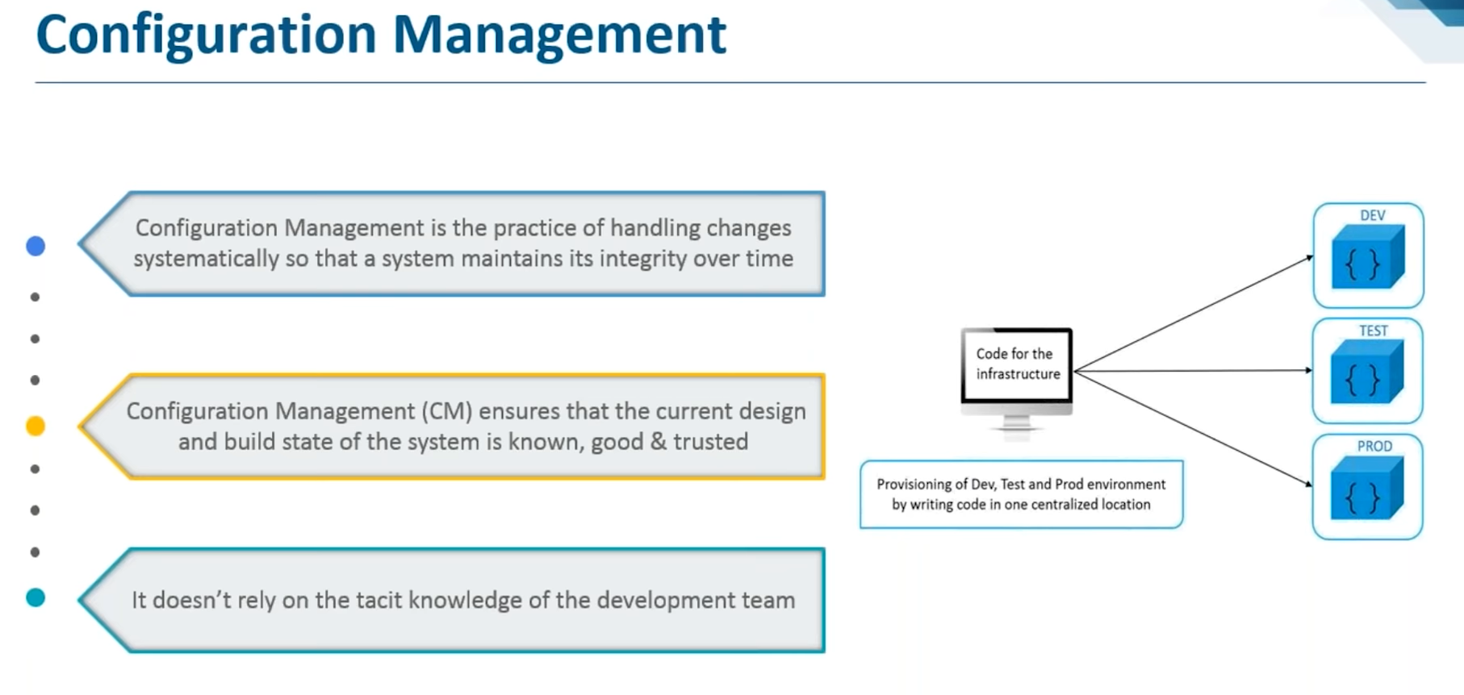

Slide 20
Clouds
Azure cloud
AWS cloud

